Slide 1


Quantophia
Back testing tool
Team: Hot spot
Maggie | Davis | Sue | Sophy

Slide 2
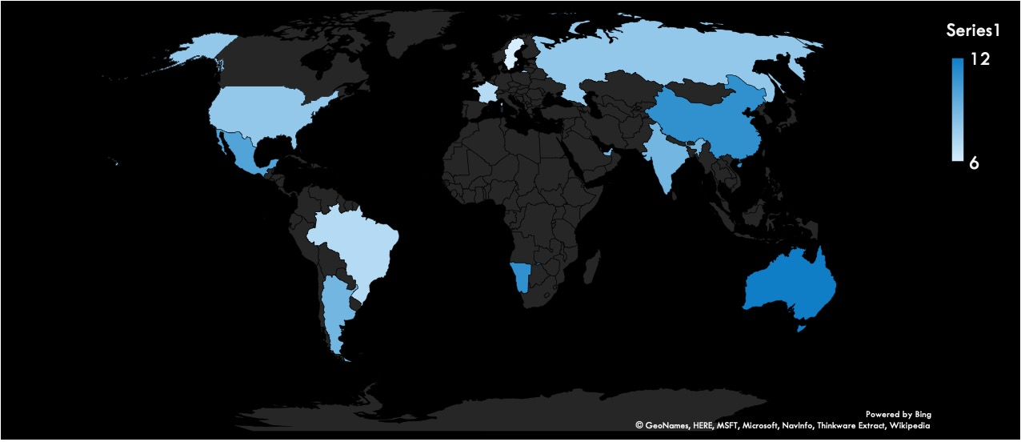
Scenario
NYC: Wall Street 9 pm

Slide 3

Scenario
Strategies ?
Back Testing ?
Quantophia
Performance ? Market ?
Metrics ?
Notes:
Choose the strategy and products together

Slide 4
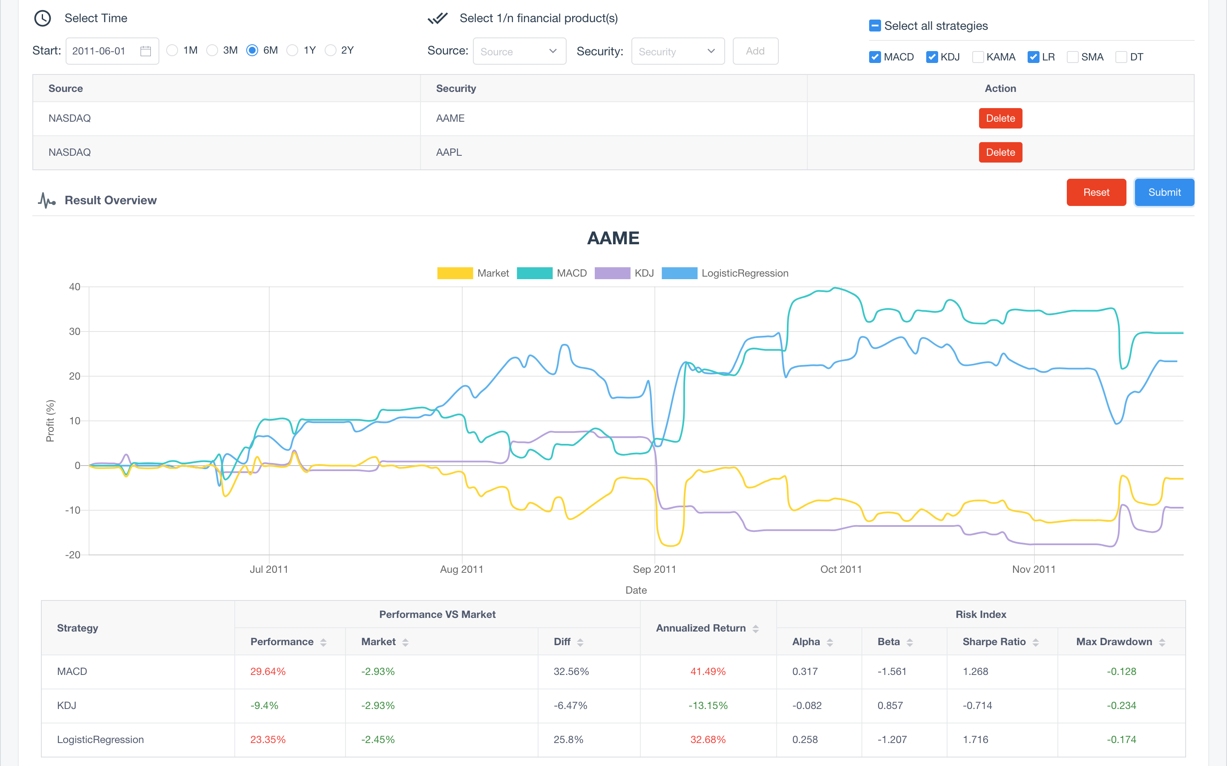
Features
1. Select Time & Products & Strategies
3 Asset Classes :
(1) Equities
(2) Derivatives
(3) Foreign Exchange
6 Strategies :
(1) KDJ (2) MACD
(3) KAMA (4) Dual Thrust
(5) Simple Multiple Average
(6) ML: Logistic Regression
2. Report: Data graph & Risk indicator
Graph :
Strategies Performance
Vs
Market performance
8 Metric Elements
(1) Strategy / Market / Diff
(2) Alpha / Beta / Sharpe /Ratio
(4) Max Drawdown
(5) Annualized Return

Slide 5

Demo

Slide 6
Roles&Tech
Maggie
Sophy
Davis
Sue
UI Design
Front-end Develop
API
Metrics
Assist Front-end Assist Strategy
Back-end Develop
Database
Assist Strategy
Back Test Strategy Design
Machine Learning
Sublime
Pycharm
Git
Postman
Swagger
Vue.js
Python Django
MySQL
Technology
Tools
Notes:
1. Roles
2. Technology
3. Lesson learned

Slide 7
Questions?
Thank you

